Slide 1

JAWAHARLAL NEHRU TECHNOLOGIAL UNIVERSITY ANANTHAPURAMU, AP, 515001
SCHOOL OF MANAGEMENT STUDIES
A SEMINAR ON INDIA’S EMERGING TWIN DEFICIT PROBLEM
SUBMITTED BY
R.NIKHILESWAR
200A1E0308
UNDER THE GUDANCE OF
Dr. B.C. LAKSHMANNA
MA, LLM, MBA, Ph.D

Slide 2
INTRODUCTION
In recently released monthly economic report, the finance ministry expressed concern about the re-emergence of the twin deficit problem in the economy due to higher commodity prices and rising subsidy burden leading to an increase in both fiscal deficit and current account deficit (CAD).

Slide 3
FISCAL DEFICIT
The fiscal deficit is the difference between the government’s total expenditure and its total receipts (excluding borrowing). A fiscal deficit occurs when this expenditure exceeds the revenue generated.
Most of the economies around the globe, including India, run under a fiscal deficit, which means the expenditure by the government is more than its income.
Fiscal Deficit = Total expenditure — Total receipts excluding borrowings

Slide 4
REASONS FOR HIGH FISCAL DEFICIT
The Fiscal Deficit can happen either due to poor revenues or high expenditures. However, the reasons for this are macroeconomic in nature. The reasons for the high fiscal deficit during COVID-19 is due to:
Lower Revenue Realization - Because of interruption in simple business deeds following the pandemic and lockdowns, the fiscal deficit has faced a lower revenue realization.
Higher Expenditure: With an identified increase in revenue expenses for food and public Maintenance and development of rural areas could be imputed in pandemic relief programs by the government, the increase in Expenditure has one noticed.

Slide 5
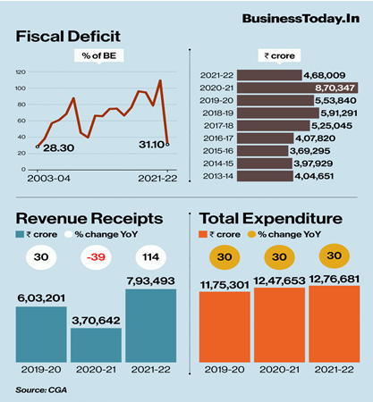

Slide 6
CURRENT ACCOUNT DEFICIT
The current account measures the flow of goods, services and investments into and out of the country. The country runs into a deficit if the value of goods and services we import exceeds the value of those we export. The current account includes net income, including interest and dividends, and transfers, like foreign aid.
Current Account = Trade gap + Net current transfers + Net income abroad
(Trade gap = Exports – Imports)

Slide 7
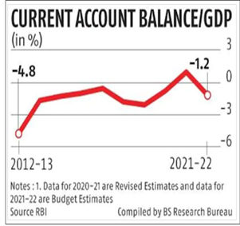
REASONS FOR CURRENT ACCOUNT DEFICIT
Overvalued Exchange Rate
Economic Growth
Decline in Export Sector
Higher Inflation
Recession in other countries
Borrowing Money

Slide 8
IMPACTS OF TWIN DEFICIT ON INDIA
Although no cause of worry in the short term, the twin deficit may in the long-term reduce the savings, depreciate the rupee and imbalance the financial investments of the government for social purposes.
Costlier imports such as crude oil and other commodities will not only widen the CAD but also put downward pressure on the rupee. A weaker rupee will, in turn, make future imports costlier.
If, in response to higher interest rates in the western economies especially the US, foreign portfolio investors (FPI) continue to pull out money from the Indian markets, that too will hurt the rupee and further increase CAD.

Slide 9
As government revenues take a hit following cuts in excise duties on diesel and petrol, upside risk to the budgeted level of gross fiscal deficit has emerged. An increase in the fiscal deficit may cause the current account deficit to widen, compounding the effects of costlier imports, and weaken the value of the rupee, thereby further aggravating external imbalances, creating the risk (admittedly low, at this time) of a cycle of wider deficits and a weaker currency.
As per the report, the recent surge in inflation in EMEs is mainly on due to supply-side shock arising from the Russian-Ukraine conflict.

Slide 10
SUGGESTIONS
Trim Revenue Expenditure (or the money government spends just to meet its daily needs).
Rationalizing Capital Expenditure to avoid fiscal slippages.
Use Tight Monetary Policy to achieve fiscal consolidation
Import Cut Of Non-essential Goods and make exports of Indian goods competitive.
Reforming The Indian Market to make it attractive for FDI and FIIs.

Slide 11
CONCLUSION
Improve the efficacy of public spending so that improvements in productivity increases in financial resources can drive higher public service delivery.
The government should focus more on attracting more FDI, create a better environment for businesses, relax some regulations, and build the necessary infrastructure.
India needs to maintain the balance of payments with its net capital inflow, which means it should focus more on FDIs rather than FPIs as a stable source of income.

Slide 12
THANK YOU

